Slide 1
Weather System A Python application for General and Aviation weather Lauren Freiler

Slide 2
WeatherApp/
├── app.py
├── services/
│ ── aviation_weather.py
│ └── openweather.py
├── tests/
├── requirements.txt
├── .env
└── .gitignore

Slide 3
User input
↓
Tkinter GUI
↓
Weather service class - AviationWx /OpenWeatherService
↓
External API
↓
JSON response
↓
Formatted display

Slide 4
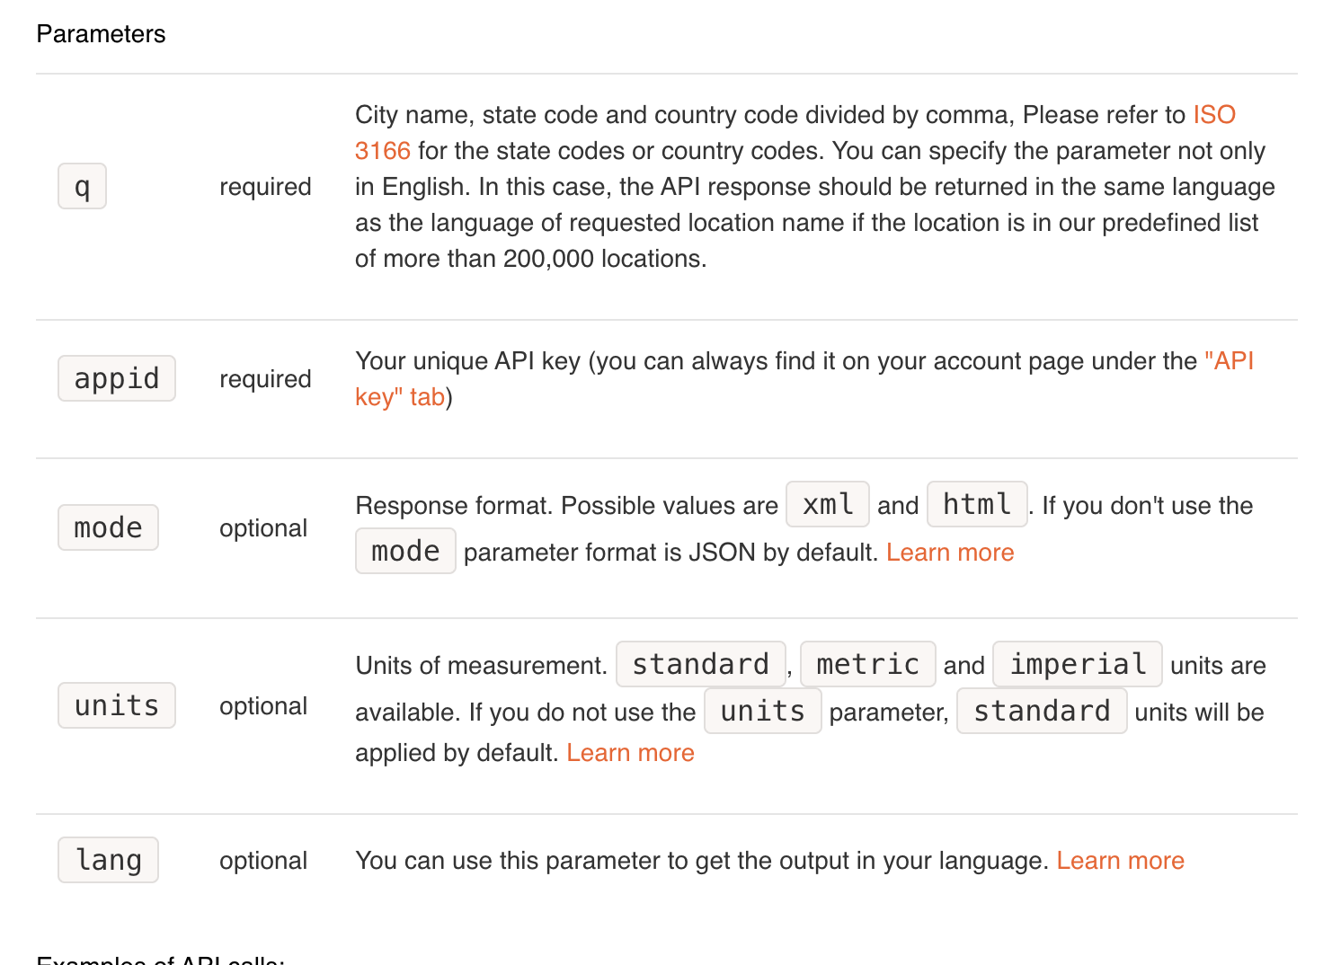
How App Retrieves Wx Data
def get_weather(self, city):
parameters = {
"q": city,
” appid": self.api_key,
"units": "imperial",
}
#sends https request
response = requests.get(
self.weather_url,
params=parameters,
timeout=10,
)
if response.status_code == 200:
return response.json()
This method:
-creates the query parameters
- sends an HTTP GET request
-converts from JSON to Python dictionaries/lists

Slide 5
Protecting API Key
from dotenv import load_dotenv
import os
load_dotenv()
api_key = os.getenv("WEATHER_API_KEY")
The actual key is stored in .env.
load_dotenv() makes the setting available to the program, and os.getenv() retrieves it. The .gitignore entry prevents the file containing the key from being uploaded to GitHub.

Slide 6
Displaying the Metar/Wx
def show_weather(self):
if self.general_weather is None:
messagebox.showerror(
"Missing API key",
"The OpenWeather API key is not configured."
)
return
city = self.city_entry.get().strip()
if not city:
messagebox.showwarning(
"Missing city",
"Please enter a city."
)
return
data = self.general_weather.get_weather(city)
if not data:
messagebox.showerror(
"Weather unavailable",
f"Weather could not be found for {city}."
)
return
temperature_f = data["main"]["temp"]
temperature_c = (
self.general_weather.fahrenheit_to_celsius(temperature_f)
)
visibility_miles = self.general_weather.meters_to_miles(
data.get("visibility", 0)
)
result = (
f"Current Weather: {data.get('name', city)}\n"
f"--------------------------------\n"
f"Condition: {data['weather'][0]['description']}\n"
f"Temperature: {temperature_f:.1f} F\n"
f"Temperature: {temperature_c:.1f} C\n"
f"Humidity: {data['main']['humidity']}%\n"
f"Wind speed: {data['wind']['speed']} mph\n"
f"Visibility: {visibility_miles:.1f} miles\n"
)
self.display_result(result)
Takes the weather data returned by the API and prepares it for display.
API originally sends the information as JSON, and Python converts that JSON into a combination of dictionaries and lists.
Using .get() returns N/A if data is missing

Slide 7
Data = {}
{'coord': {'lon': -122.3321, 'lat': 47.6062}, 'weather': [{'id': 500, 'main': 'Rain', 'description': 'light rain', 'icon': '10d'}], 'base': 'stations', 'main': {'temp': 60.6, 'feels_like': 60.22, 'temp_min': 58.17, 'temp_max': 63.05, 'pressure': 1023, 'humidity': 82, 'sea_level': 1023, 'grnd_level': 1013}, 'visibility': 10000, 'wind': {'speed': 5.01, 'deg': 198, 'gust': 8.99}, 'rain': {'1h': 0.25}, 'clouds': {'all': 100}, 'dt': 1785690662, 'sys': {'type': 2, 'id': 2009669, 'country': 'US', 'sunrise': 1785674890, 'sunset': 1785728573}, 'timezone': -25200, 'id': 5809844, 'name': 'Seattle', 'cod': 200}

